Slide 1
Book Recommendation System Using Collaborative Filtering Algorithm
Team Members:
Supervisor :
Rabin Neupane
Ritesh RC
Sushil Shrestha
Mr. Chakra Narayan Rawal

Slide 2
Introduction
A book recommendation system predicts user preferences and suggests relevant information based on those preferences..
It assists users in discovering books tailored to their preferences.
The users can request specific titles and the system suggests similar books based on their preferences.
It simplifies the process of browsing and selecting preferred books.

Slide 3
Problem Statement
Readers often struggle to find books matching their preferences in the vast world of literature.
Difficulty in providing relevant suggestions for new users.
Limited diversity in suggested books.

Slide 4
Objectives
To recommend on the basic of similarities calculated from book ratings given by users.
Providing relevant suggestions for new users.

Slide 5
Scope
Automating book recommendation processes to enhance user experience and efficiency.
Maintaining accurate and updated user reading preferences to improve the relevance of recommendations.
Maintaining accurate and updated leave balance.
Providing insights into popular genres and trending books for better understanding of user interests and market trends.
Facilitating compliance with privacy regulations to protect user data while delivering personalized recommendations.

Slide 6
Limitations
User-provided data inaccuracies can undermine recommendation accuracy.
Insufficient or low-quality data on books and user preferences hampers relevance.
Inability to address complex recommendation scenarios that require human intervention.
Unique user tastes not well-represented in data may lead to inaccurate recommendations.

Slide 7
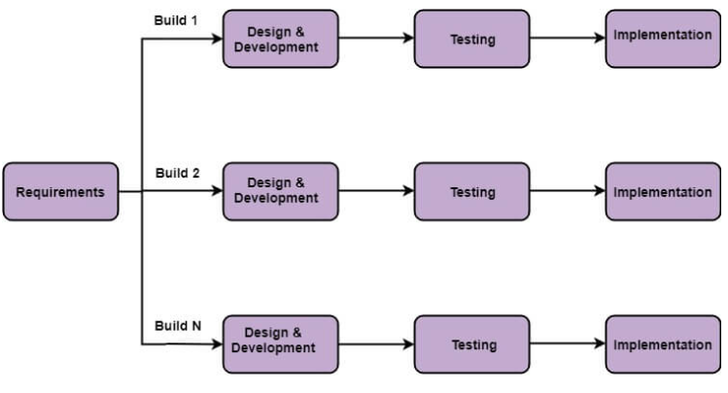
Development Method
The project follows an incremental delivery methodology, an iterative software development approach where the system evolves through a series of incremental iterations, gradually adding features upon previous ones to deliver a fully functional system.

Slide 8
Background Study
In recent years, as entertainment shifts online, consumers face decision paralysis due to the vast selection of books available. A Book Recommender system can address this by providing personalized suggestions based on viewing history and preferences.
Creating a Book Recommender system requires skills in machine learning, data analysis, and software development to gather and analyze user data for personalized suggestions. It must also be scalable and user-friendly.

Slide 9
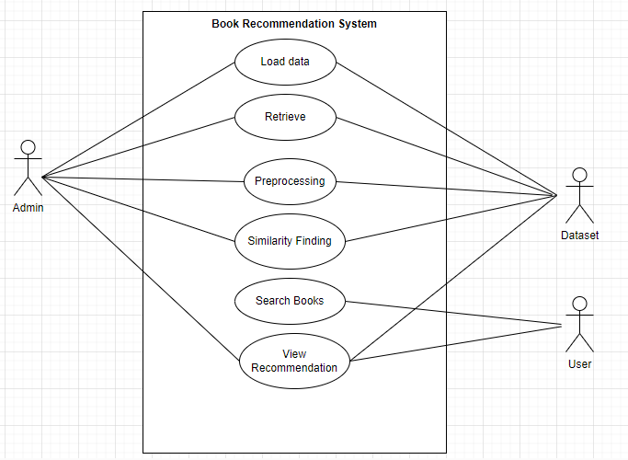
System Analysis
Use Case Diagram

Slide 10
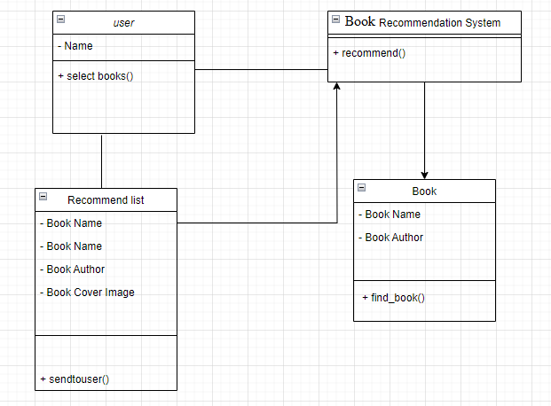
Class Diagram

Slide 11
Feasibility Analysis
1.Technical
This web-based application employs collaborative filtering to recommend books to users. Recommendations can be prioritized based on various factors such as user preferences or popularity of the books.
2.Operational
The system's operational feasibility assesses its capacity to address the defined problem, utilize scope opportunities, and fulfill requirements, aiming to be reliable, maintainable, usable, sustainable, and affordable.
3.Economic
This project is done using our understanding of available languages and technologies.
4.Schedule
The system is to be completed within time constraints.

Slide 12
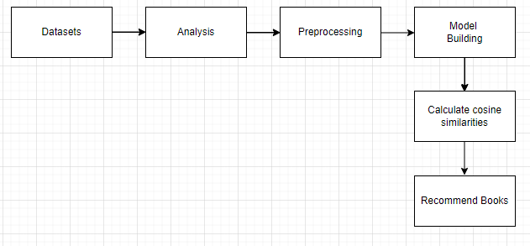
System Design
System Design of Book Recommendation System

Slide 13
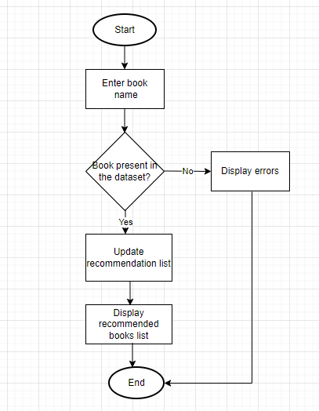
Flowchart

Slide 14
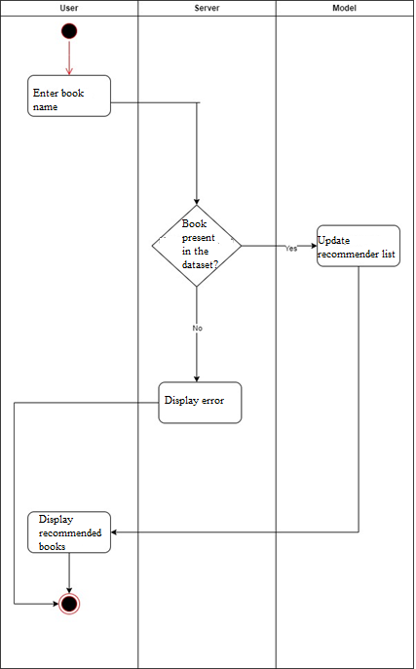
Activity Diagram

Slide 15
Algorithm Used
Collaborative Filtering
Collaborative filtering predicts user preferences by analyzing similar users' behavior, recommending items based on shared tastes.
Unlike content-based filtering, it allows for serendipitous recommendations and automatic learning of embeddings without manual feature engineering.

Slide 16
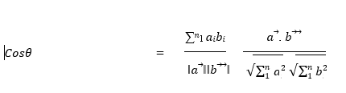
Algorithm Used
-Cosine Similarity
Cosine similarity is a measure that helps to find out how similar data objects are, regardless of size. Mathematically, it is the cosine of the angle between two vectors projected in a multi-dimensional space.
Where, 𝑎⃗. 𝑏⃗⃗ = ∑^{𝑛}₁ 𝑎_{𝑖}𝑏_{𝑖} = 𝑎_{𝑖}𝑏_{𝑖} + 𝑎₂𝑏₂ + ⋯ + 𝑎_{𝑛}𝑏_{𝑛} is the dot product of the two vectors.
The angle between two vectors determines its direction and is measured in ‘θ’. This angle can be calculated by using above equation
When θ = 0 °, the `x` and` y` vectors overlap and prove to be similar.
When θ = 90 °, the `x` and` y` vectors are therefore dissimilar

Slide 17
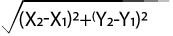
K-Nearest Neighbor
KNN predicts the value of a data point based on the average value of its 'k' nearest neighbors. Euclidean distance is commonly used to measure the distance between data points. The formula to calculate Euclidean distance between two points are:
Euclidean distance between two points =
By calculating the Euclidean distance, we got the nearest neighbors

Slide 18
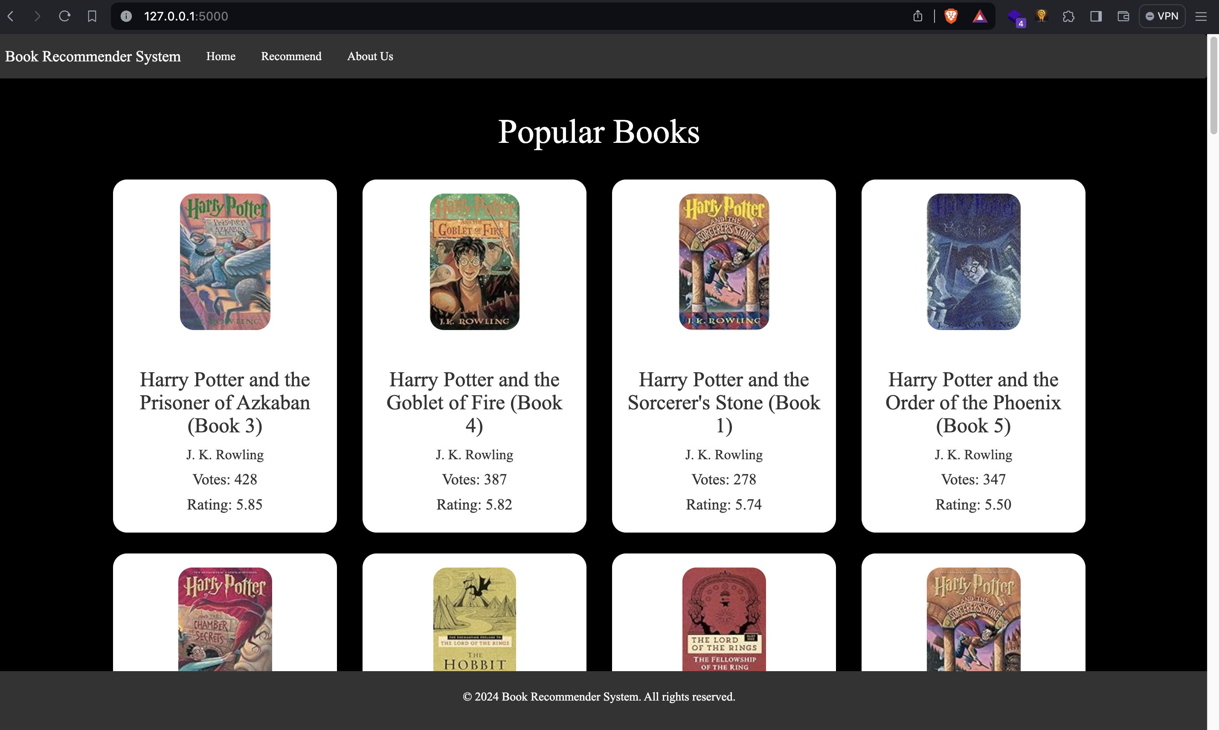
Outcome
Home Page

Slide 19
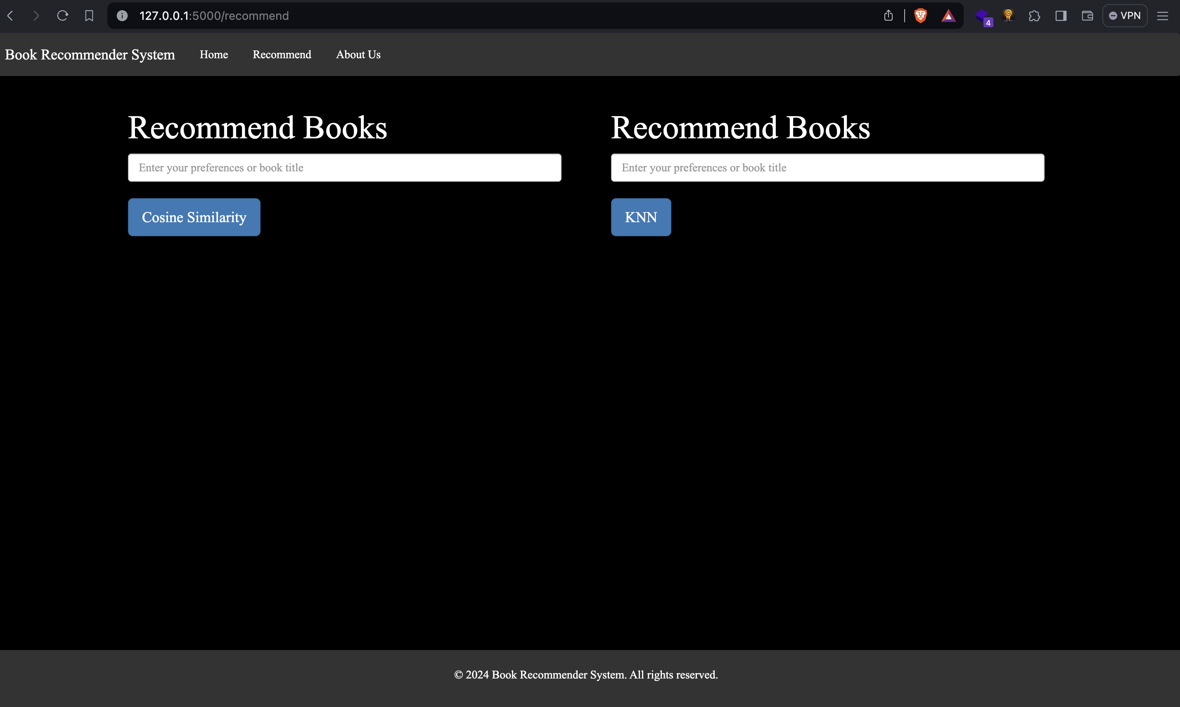
Recommend

Slide 20
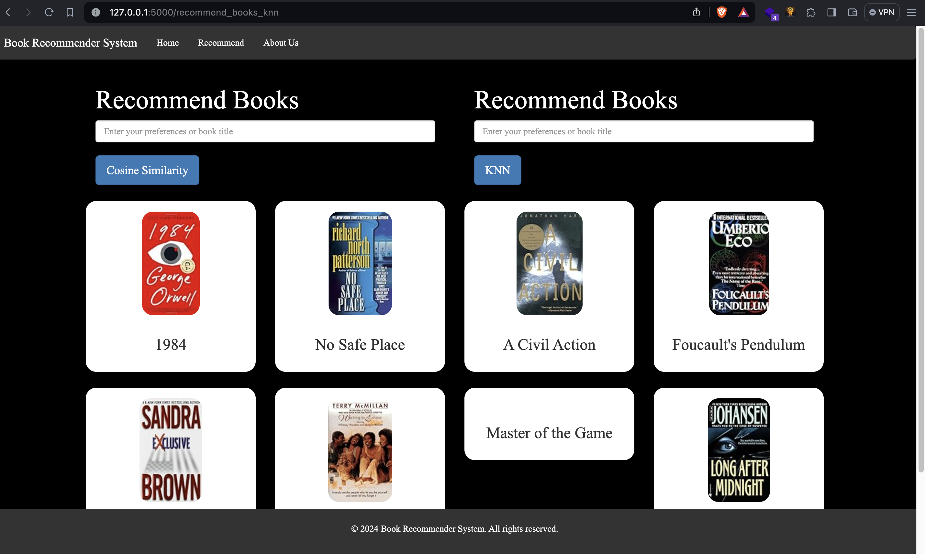
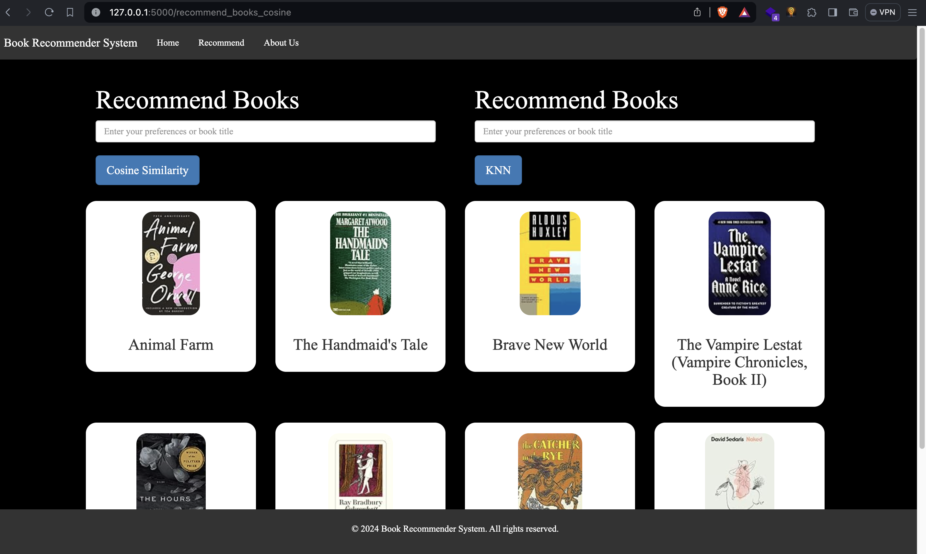
Book Recommendation with KNN
Book Recommendation with Cosine Similarity

Slide 21
Conclusion
The proposed system describes an digital system that progresses from the traditional method of paper generation to an digital process.
It provides recommendation on the basis of ratings.

Slide 22
REFERENCES
[1] “Collaborative Filtering | Machine Learning | Google for Developers.” Google, Google, developers.google.com/machine-learning/recommendation/collaborative/basics. Accessed 19 Mar. 2024.
[2] “Cosine Similarity, Clearly Explained!!!” YouTube, YouTube, 30 Jan. 2023, www.youtube.com/watch?v=e9U0QAFbfLI&t=515s.
[3] “K-Nearest Neighbor(KNN) Algorithm for Machine Learning - Javatpoint.” Www.Javatpoint.Com, www.javatpoint.com/k-nearest-neighbor-algorithm-for-machine- learning. Accessed 19 Mar. 2024

